Slide 1
Static

Slide 2
What is static in Java
Static is Keyword in Java
Static is used to manage memory effectively
Class variables, constants, and methods can be declared as static.
In this context, static means that the variable, constant, or method belongs to the class.
Static Variables
  All instance variables labeled as static are class level variables not the instance variables
  All static variables can be accessed directly with class we need not to create any instance to access the static variables
  So all the static variables belong to class not to any instance

Slide 3
Static Varibales
Class Student{
public static int staticAge = ; // All instances of Student have this variable as public int studentHeight = 6 ;
}
Class studentExecution{
public static void main(String args[]){
Student.staticAge = 35; // when we use the class name, the class is loaded, direct access to a without any instance
Student.b=22; // Try this in IDE and see ??Error
Student testStudent = new Student();
testStudent.b = 200; // valid to set a value for a non static variable after creating an instance.
}
}

Slide 4
Static methods
Recall, how do we call a method so far any class?
Student s = new Student(“Good Student”, 23, 1989);
String s = s.toString( );
This is called non static method
Non static methods are can not called using the class name we are forced to create an object for the class in order to access the non static method
Non static methods can not called from the static context
Static methods are class level methods
Need not to create any instance to access the static methods so no need of constructor
Static methods does not have this
Static methods can not access or refer non static variables, constants and methods

Slide 5
Static Method example
Class Student{
public static typeOfStudent(){
System.out.println(“I am static”);
}
public static nonStaticTypeOfStudent(){
System.out.println(“I am non static ”);
} }
Class studentExecution{
public static void main(String args[]){
Student testStudent = new Student();
testStudent. typeOfStudent(); //Prints I am static
Student.typeOfStudent(); //Prints I am static
testStudent. nonStaticTypeOfStudent(); //Prints I am non static
Student. nonStaticTypeOfStudent() //Try this in IDE What error is displayed?
}
}

Slide 6
Static Constants
Static constant are class level constants
Can be accessed with class name no need of creating any instance for the class
Class Student{
Private static int STUDENT_AGE = 24; // Static constants are declared and initialized at a time
}
Class studentExecution{
public static void main(String args[]){
int studnetAge = Stundet. STUDENT_AGE; //wil assign the 24 to studentAge
system.out.println(studentAge) //prints 24
}
}

Slide 7
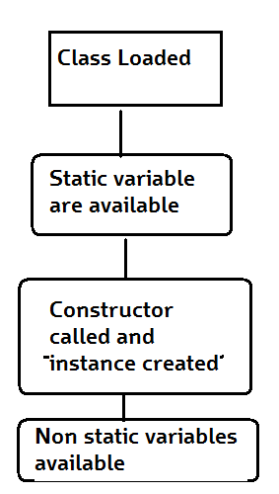
How static works
Below diagram explains when the static content and non static content is available for the program to access

Slide 8
Stack and Heap Memory
The End

